Slide 1

Deep Learning for Rumour Detection and Claim Veracity Assessment on Social Media
PhD Thesis Defense
CHEUNG Tsun Hin
Supervisor: Prof. LAM Kin Man
Date: 28 December 2023

Slide 2
Introduction and Background

Slide 3




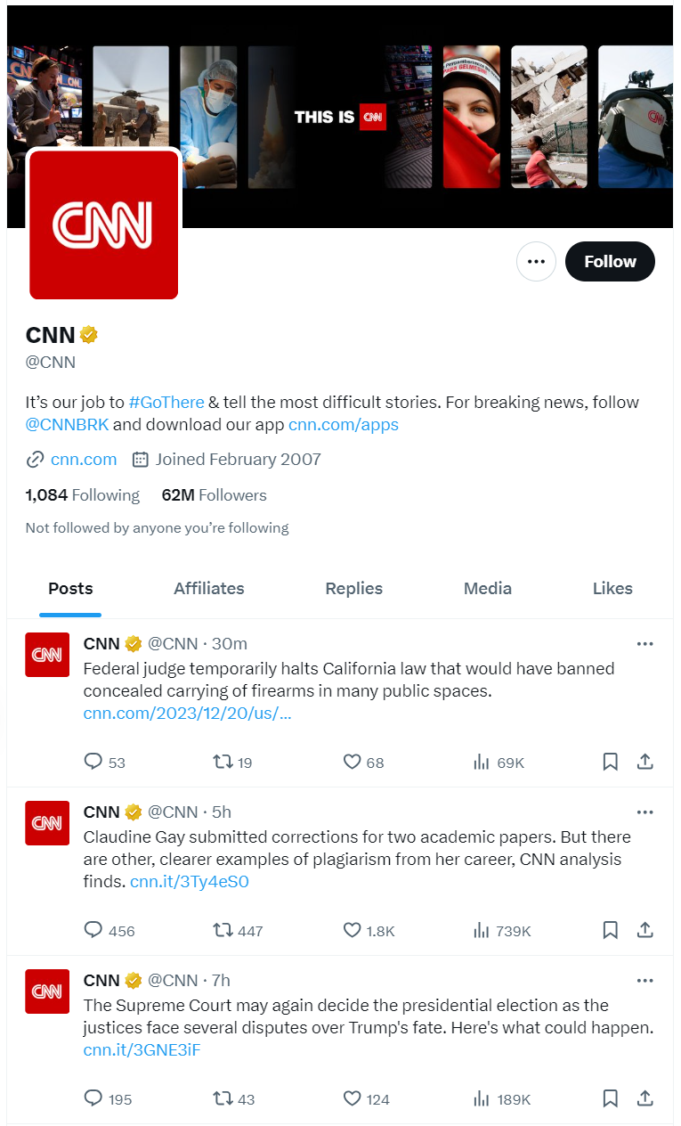


Online Social Media
Social media has become a convenient way for people to exchange information.
Twitter (rebranded to after Elon Musk’s acquisition in 2023.)
Weibo (605 million monthly active users, as of 2023.)
Threads (decentralized social media platform by Meta’s Instagram, released in July 2023; 141 million users now.)

Slide 4
Online Social Media
Social media has become a convenient way for people to exchange information.
Twitter (rebranded to after Elon Musk’s acquisition in 2023.)
Weibo (605 million monthly active users, as of 2023.)
Threads (decentralized social media platform by Meta’s Instagram, released in July 2023; 141 million users now.)
Why is social media important?

Slide 5
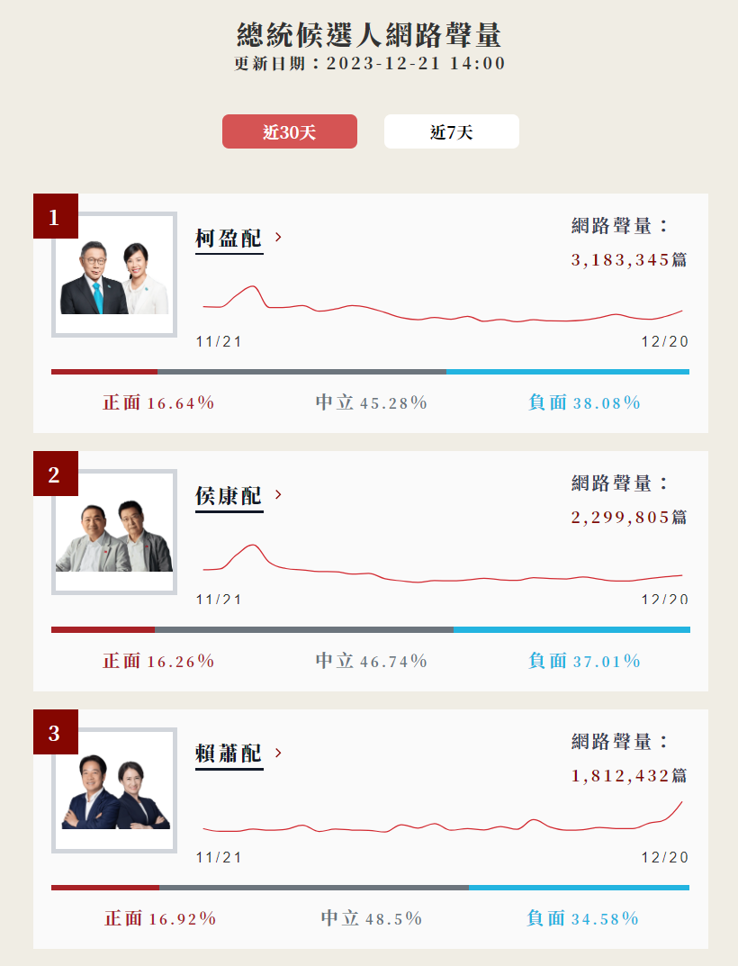
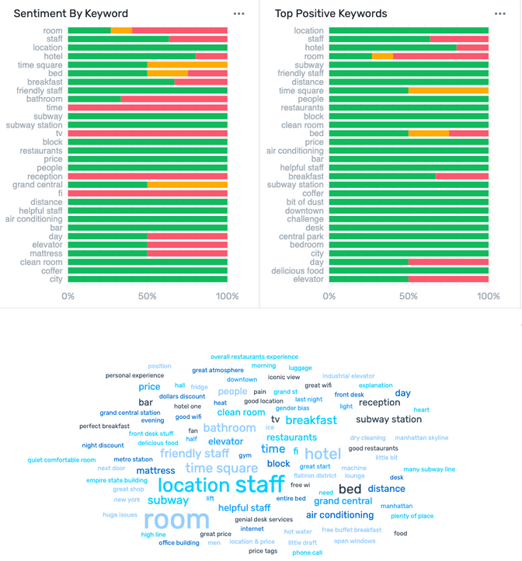
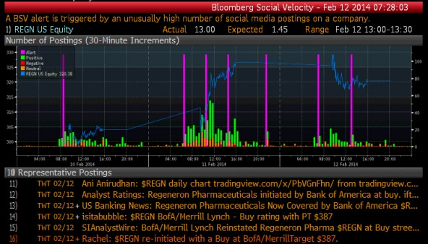
Social Media as Information Sources
Social media has become sources for information. For examples, for companies to understand customers' opinions, for investors to capture markets’ sentiment. It also provides valuable insights during elections.
(b) Social Velocity and Stock Market Tracing In Bloomberg
(c) Social Monitoring in
Taiwan Election 2024
Brand Monitoring

Slide 6
Social Media as Information Sources
Social media has become sources for information. For examples, for companies to understand customers' opinions, for investors to capture markets’ sentiment. It also provides valuable insights during elections.
Is social media a reliable source of information?
(b) Social Velocity and Stock Market Tracing In Bloomberg
(c) Social Monitoring in
Taiwan Election 2024
Brand Monitoring

Slide 7
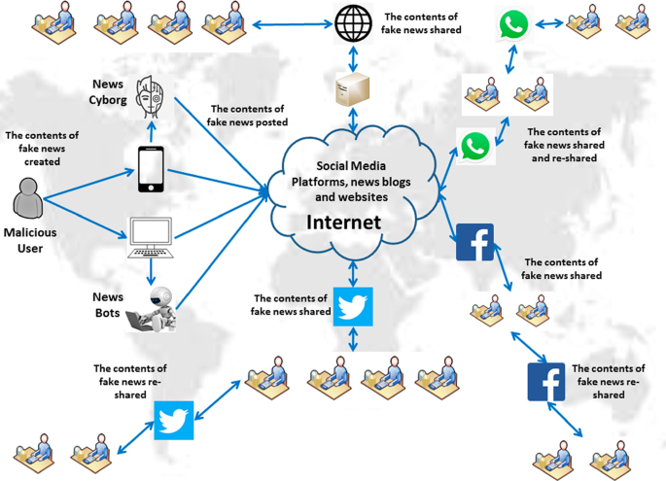
Misinformation on Social Media
Social media provides a real-time platform for the dissemination of information, including the spread of fake news.
[1] Hakak et al., “Propagation of Fake News on Social Media: Challenges and Opportunities,” Computational Data and Social Networks, 2020.

Slide 8

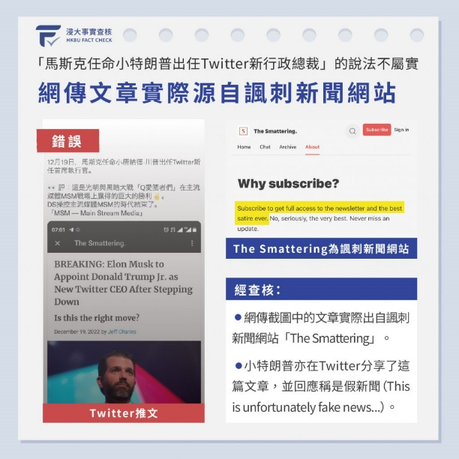
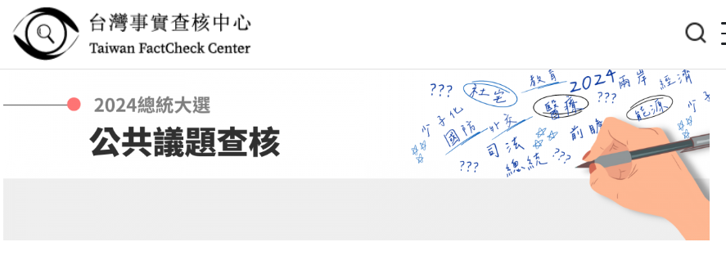

Manual Fact-Checking Websites
Manual fact-checking websites provide platforms for people to verify statements, but they often rely on human annotations.
(a) PolitiFact
(b) HKBU FACT CHECK
(c) Taiwan FactCheck Center
Examples of manual fact-checking websites.

Slide 9
Manual Fact-Checking Websites
Manual fact-checking websites provide platforms for people to verify statements, but they often rely on human annotations.
Manual Fact-Checking is time consuming and labor intensive.
(a) PolitiFact
(b) HKBU FACT CHECK
(c) Taiwan FactCheck Center
Examples of manual fact-checking websites.

Slide 10
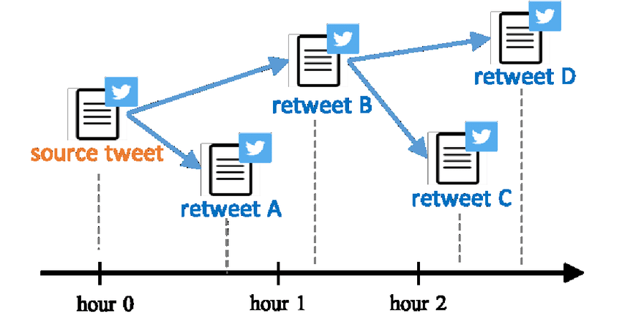
Rumour Detection and Claim Veracity Assessment
Task 1: Rumour Detection
Detect unverified and false information (source tweet) at posting.
Rumour: Information unverified, of uncertain origin, or false at the time of posting.
Non-Rumour: Information verified and confirmed as true or not a rumour at the time of posting.
Task 2: Claim Veracity Assessment
Assess the truthfulness of rumours post-posting.
True Rumour: Information verified and confirmed as true.
False Rumour: Information verified and confirmed as false.
Unverified Rumour: Information for which the veracity cannot be confirmed.
Rumour Detection
Claim Veracity Assessment
[2] Zubiaga et al., “Detection and Resolution of Rumours in Social Media,” ACM Computing Surveys, vol. 51, no. 2, pp. 1–36, 2018.

Slide 11

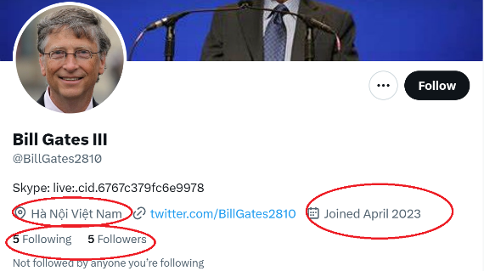
Task 1: Rumour Detection
I. Multimodal Source [3]
II. User Credibility [4]
Dynamic User Behavior: Adapting to evolving user behavior adds complexity to credibility assessment.
Contextual User Profiling: Creating generalized models for user credibility requires accounting for contextual variations.
Semantic Gap: Bridging the semantic gap between textual and visual features is a key challenge in capturing nuanced relationships.
Diverse Content Types: Text and images pose challenges (e.g., Instagram and Xiaohongshu).
[3] T. Cheung and K. Lam, “Crossmodal bipolar attention for multimodal classification on social media,” Neurocomputing, vol. 514, pp. 1–12,
Dec. 2022.
[4] T. Cheung and K. Lam, “Author-Aware Rumour Detection with Layer-Wise Parameter-Efficient Tuning and Incomplete Feature Learning,”
submitted to IEEE Access.

Slide 12


Task 2: Claim Veracity Assessment
III. Community Response [5]
Diverse Reactions: The wide array of responses to claims on social media introduces challenges in distinguishing between genuine and deceptive information.
Temporal Dynamics: The evolving nature of community responses over time necessitates real-time analysis for accurate veracity assessment.
IV. External Evidence [6]
Data Source Reliability: Assessing the reliability of external evidence from various sources is a persistent challenge.
Integration Complexity: Effectively combining and integrating external evidence demands sophisticated model architectures.
[5] T. Cheung and K. Lam, “Causal diffused graph-transformer network with stacked early classification loss for efficient stream classification of rumours,” Knowledge-Based Systems, vol. 277, pp. 110807, 2023.
[6] T. Cheung and K. Lam, “FactLLaMA: Optimizing Instruction-Following Language Models with External Knowledge for Automated Fact-Checking,” in Proceedings, APSIPA ASC 2023, Oct. 31, 2023.

Slide 13
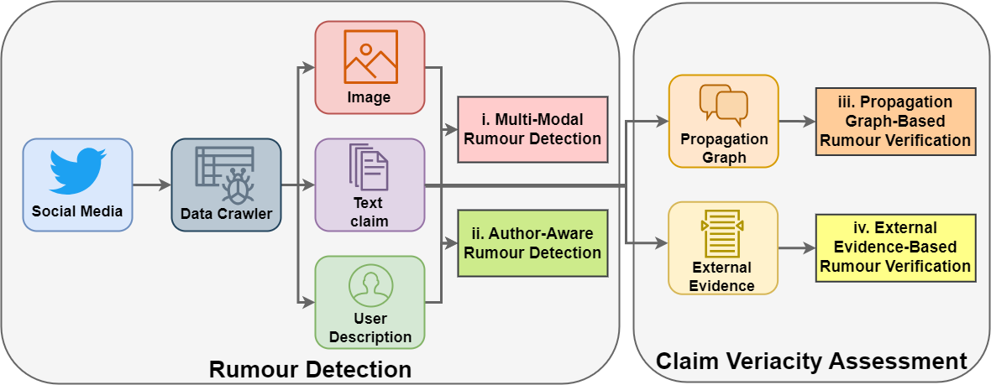
Overview of This Thesis
Figure 3 An overview of the rumour detection and claim veracity assessment system on social media studied in this thesis.

Slide 14
I. Multimodal Image-Text Rumour Detection
[3] T. Cheung and K. Lam, “Crossmodal bipolar attention for multimodal classification on social media,” Neurocomputing, vol. 514, pp. 1–12, Dec. 2022.

Slide 15

Motivation
Background
Multimodal image-text rumor detection on social media has received increasing attention in recent years.
Question
How can we effectively model the semantic relationship between the two modalities?
Challenge
Existing methods ignore the inconsistent between the modalities. Both consistent and inconsistent semantic meanings between the modalities are important for multimodal classification on social media.

Slide 16
Contributions
Modeling Cross-Modal Relationships
A novel cross-modal bipolar attention (CBAN) mechanism.
Direct and inverse textual-visual feature relationships.
Feature Utilization and Aggregation
Utilizing Vision Transformer (ViT)'s hidden representations for multimodal classification.
Attentive pooling module for feature transformation.

Slide 17
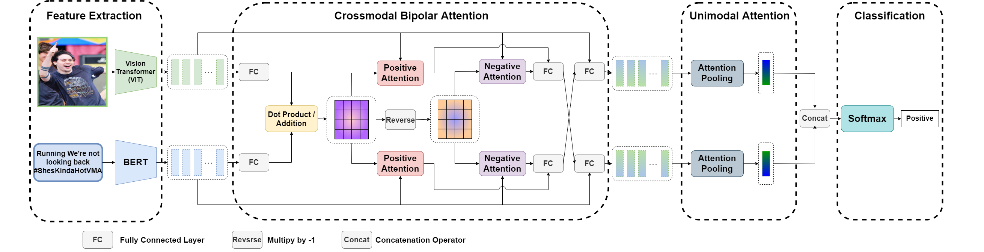
Model Overview of Crossmodal Bipolar Attention
Feature Extraction: Encode the unimodal information into embeddings.
Crossmodal Bipolar Attention: Fuse the unimodal features into the cross-modal features.
Unimodal Attention: Aggregate the fused features into the final representation.
Classification: Classify the final representation into either rumour or non-rumour.

Slide 18
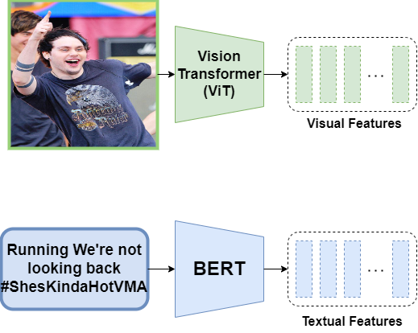
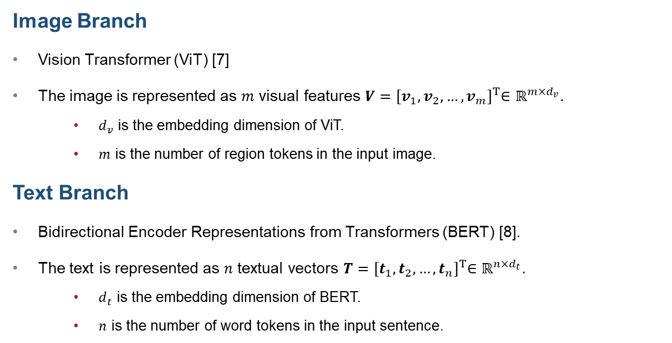
Feature Extraction Modules
Image Branch
Vision Transformer (ViT) [7]
The image is represented as $m$ visual features $V={[v_{1},v_{2},…,v_{m}]}^{T}∈ℝ^{m×d_{v}}$.
$d_{v}$ is the embedding dimension of ViT.
$m$ is the number of region tokens in the input image.
Text Branch
Bidirectional Encoder Representations from Transformers (BERT) [8].
The text is represented as $n$ textual vectors $T={[t_{1},t_{2},…,t_{n}]}^{T}∈ℝ^{n×d_{t}}$.
$d_{t}$ is the embedding dimension of BERT.
$n$ is the number of word tokens in the input sentence.
[7] Dosovitskiy et al., “An Image is Worth 16x16 Words: Transformers for Image Recognition at Scale,” ICLR, 2021.
[8] Devlin et al., “BERT: Pre-training of deep bidirectional transformers for language understanding,” NAACL, 2019.

Slide 19
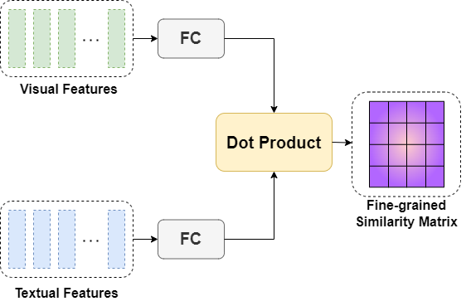
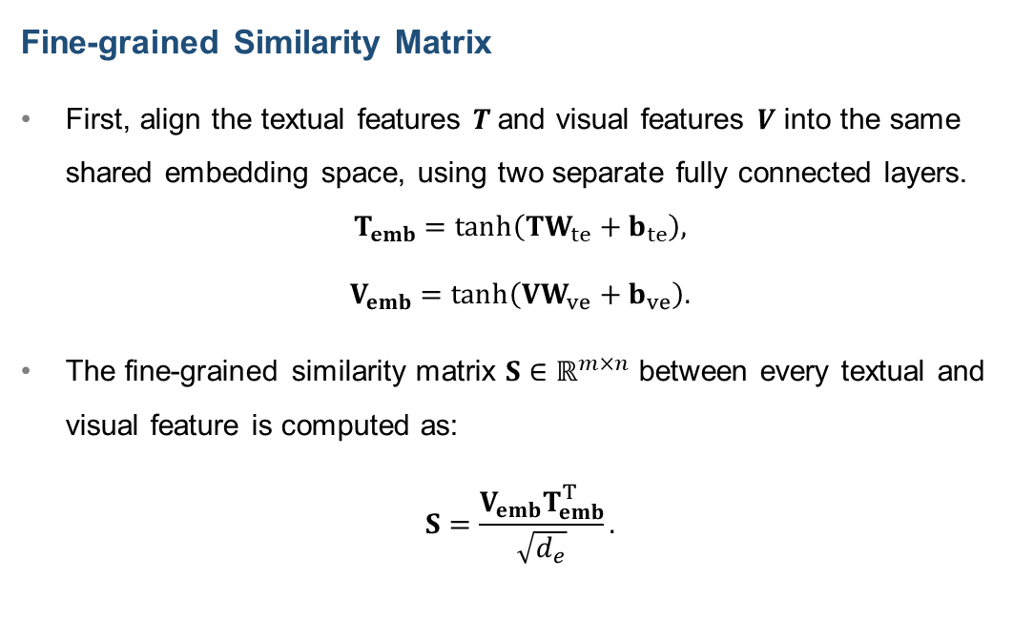
Crossmodal Bipolar Attention
Fine-grained Similarity Matrix
First, align the textual features $T$and visual features $V$ into the same shared embedding space, using two separate fully connected layers.
$$T_{emb}=\tanh\left(TW_{te}+b_{te}\right),$$
$$V_{emb}=\tanh\left(VW_{ve}+b_{ve}\right).$$
The fine-grained similarity matrix $S∈ℝ^{m×n}$ between every textual and visual feature is computed as:
$$S=\frac{V_{emb}T_{emb}^{T}}{\sqrt{d_{e}}}.$$

Slide 20
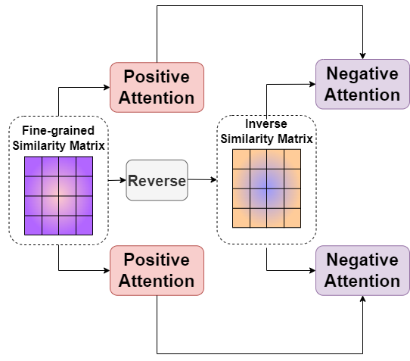


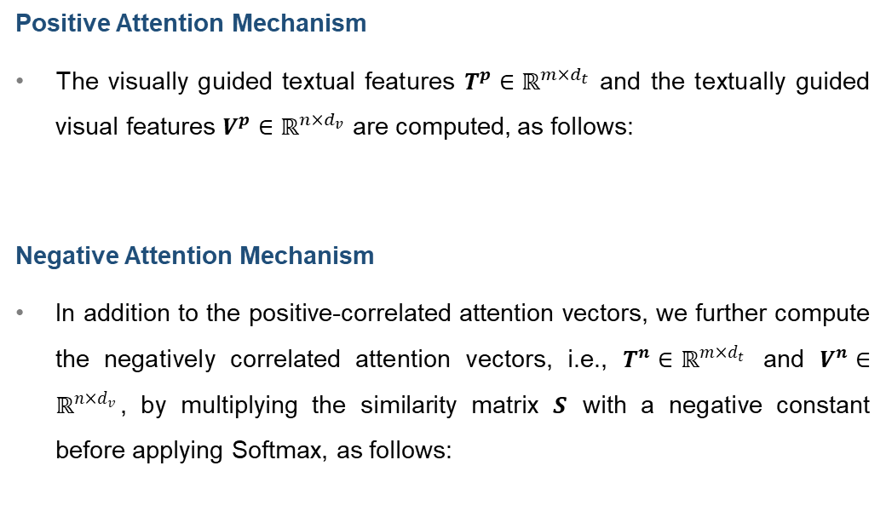
Crossmodal Bipolar Attention
Positive Attention Mechanism
The visually guided textual features $T^{p}∈ℝ^{m×d_{t}}$ and the textually guided visual features $V^{p}∈ℝ^{n×d_{v}}$ are computed, as follows:
Negative Attention Mechanism
In addition to the positive-correlated attention vectors, we further compute the negatively correlated attention vectors, i.e., $T^{n}∈ℝ^{m×d_{t}}$ and $V^{n}∈ℝ^{n×d_{v}}$, by multiplying the similarity matrix $S$ with a negative constant before applying Softmax, as follows:
$T^{p}=softmax\left(S\right)T$,
$$V^{p}=softmax\left(S^{T}\right)V.$$
$T^{n}=softmax\left(−S\right)T$,
$$V^{n}=softmax\left({−S}^{T}\right)V.$$

Slide 21
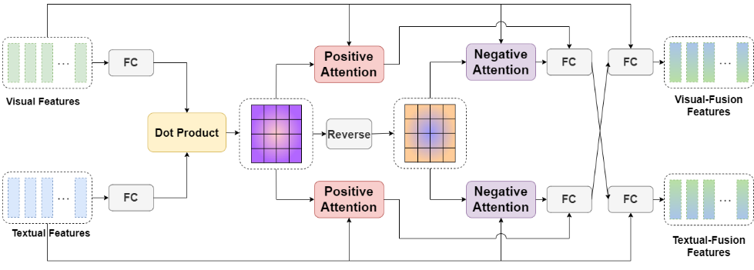
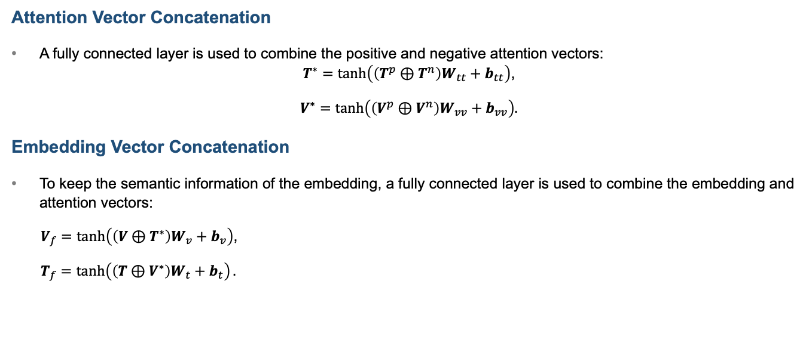
Attention Vector Aggregation
Attention Vector Concatenation
A fully connected layer is used to combine the positive and negative attention vectors:
$T^{∗}=\tanh\left(\left(T^{p}⊕T^{n}\right)W_{tt}+b_{tt}\right)$,
$V^{∗}=\tanh\left(\left(V^{p}⊕V^{n}\right)W_{vv}+b_{vv}\right).$
Embedding Vector Concatenation
To keep the semantic information of the embedding, a fully connected layer is used to combine the embedding and attention vectors:
$V_{f}=\tanh\left(\left(V⊕T^{∗}\right)W_{v}+b_{v}\right)$,
$T_{f}=\tanh\left(\left(T⊕V^{∗}\right)W_{t}+b_{t}\right).$

Slide 22
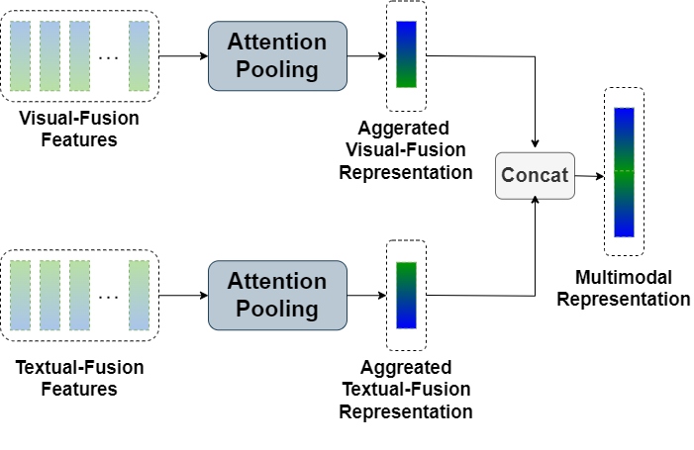
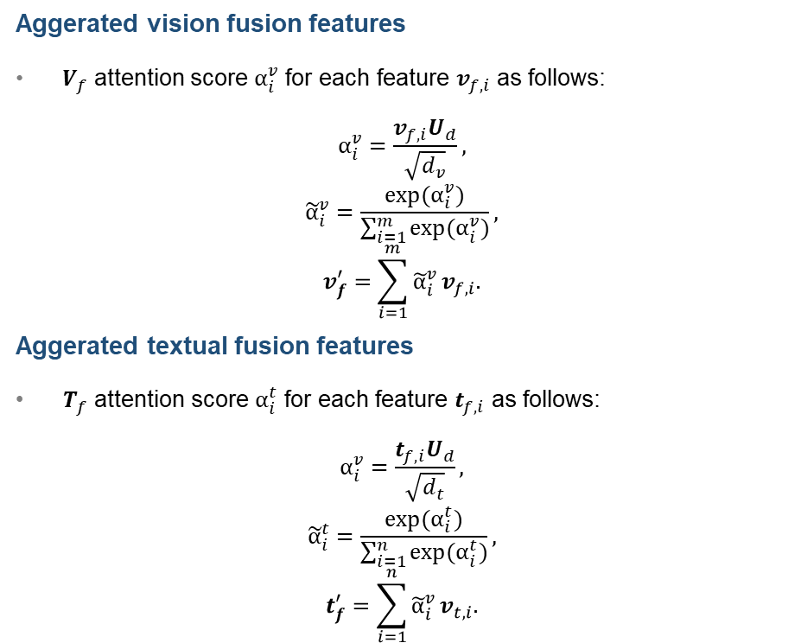
Unimodal Attention Pooling
Aggerated vision fusion features
$V_{f}$ attention score $α_{i}^{v}$ for each feature $v_{f,i}$ as follows:
$$α_{i}^{v}=\frac{v_{f,i}U_{d}}{\sqrt{d_{v}}},$$
$${\tilde{α}}_{i}^{v}=\frac{exp(α_{i}^{v})}{\sum_{i=1}^{m}{exp(α_{i}^{v})}},$$
$$v_{f}^{′}=\sum_{i=1}^{m}{{\tilde{α}}_{i}^{v}}v_{f,i}.$$
Aggerated textual fusion features
$T_{f}$ attention score $α_{i}^{t}$ for each feature $t_{f,i}$ as follows:
$$α_{i}^{v}=\frac{t_{f,i}U_{d}}{\sqrt{d_{t}}},$$
$${\tilde{α}}_{i}^{t}=\frac{exp(α_{i}^{t})}{\sum_{i=1}^{n}{exp(α_{i}^{t})}},$$
$$t_{f}^{′}=\sum_{i=1}^{n}{{\tilde{α}}_{i}^{v}}v_{t,i}.$$

Slide 23
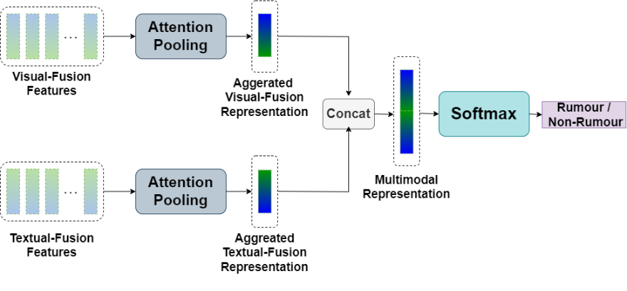
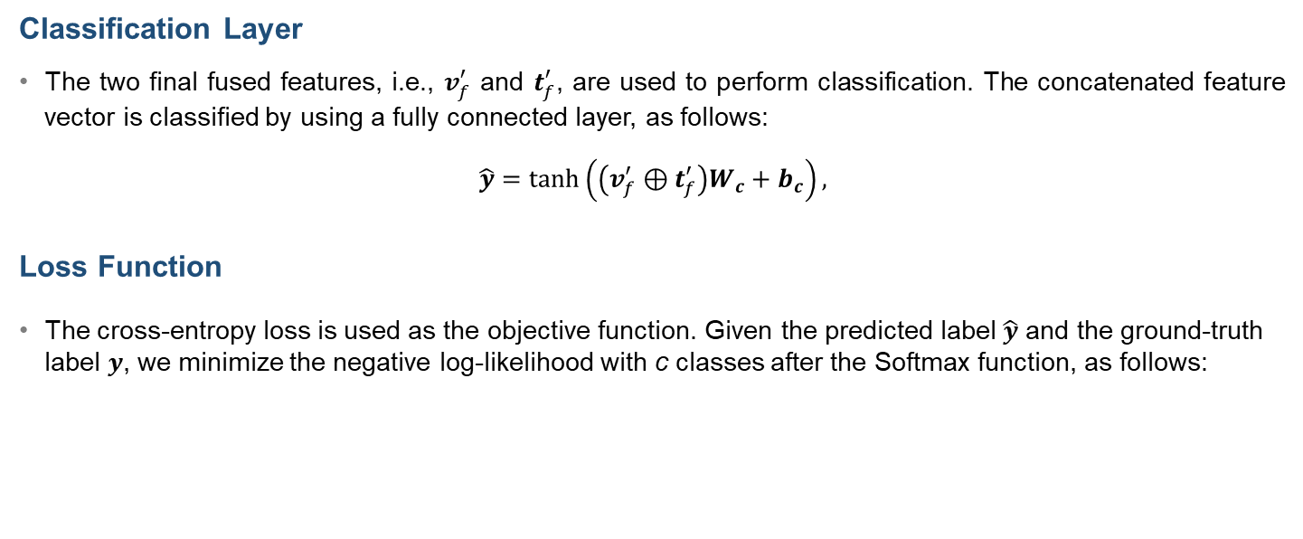

Classification Layer and Loss Function
Classification Layer
The two final fused features, i.e., $v_{f}^{′}$ and $t_{f}^{′}$, are used to perform classification. The concatenated feature vector is classified by using a fully connected layer, as follows:
$$\hat{y}=\tanh\left(\left(v_{f}^{′}⊕t_{f}^{′}\right)W_{c}+b_{c}\right),$$
Loss Function
The cross-entropy loss is used as the objective function. Given the predicted label $\hat{y}$ and the ground-truth label $y$, we minimize the negative log-likelihood with c classes after the Softmax function, as follows:
$Loss = −\sum_{i}^{c}{ylog\left(softmax\left(\hat{y}\right)\right)}.$

Slide 24
Experimental Details
Datasets
PHEME [9]: 1972 rumours, 3030 non-rumours, from Twitter.
Weibo [10]: 6226 rumours, 9405 non-rumours, from Weibo.
Hyperparameters
For all experiments, the models were trained with a mini-batch size of 64 for 10 epochs. We use the Adam Optimizer with a fixed learning rate of 0.00002.
[9] Augbiaga et al., “Exploiting Context for Rumour Detection in Social Media,” Int. Conf. on Social Informatics,” 2017.
[10] Jin et al., “Multimodal Fusion with Recurrent Neural Networks for Rumour Detection on Microblogs,” ACM MM, 2017.

Slide 25
Results on PHEME Dataset
Methods | Accuracy | Precision | Recall | F1
SVM [42] | 0.639 | 0.638 | 0.641 | 0.639
GRU [28] | 0.832 | 0.819 | 0.804 | 0.805
CNN [43] | 0.779 | 0.766 | 0.741 | 0.749
TextGCN [44] | 0.828 | 0.801 | 0.782 | 0.783
Att-RNN [18] | 0.850 | 0.834 | 0.824 | 0.829
EANN [16] | 0.681 | 0.693 | 0.707 | 0.721
MVAE [45] | 0.852 | 0.839 | 0.818 | 0.827
SAFE [46] | 0.811 | 0.817 | 0.750 | 0.767
MMCN [47] | 0.872 | 0.863 | 0.850 | 0.856
CBAN (Ours) | 0.894 | 0.868 | 0.878 | 0.894

Slide 26
Results on WEIBO Dataset
Methods | Accuracy | Precision | Recall | F1
SVM [42] | 0.640 | 0.696 | 0.686 | 0.679
GRU [28] | 0.720 | 0.709 | 0.702 | 0.699
CNN [43] | 0.740 | 0.742 | 0.740 | 0.740
TextGCN [44] | 0.787 | 0.844 | 0.863 | 0.777
Att-RNN [18] | 0.772 | 0.787 | 0.838 | 0.769
EANN [16] | 0.782 | 0.790 | 0.818 | 0.780
MVAE [45] | 0.824 | 0.828 | 0.829 | 0.823
SAFE [46] | 0.763 | 0.775 | 0.846 | 0.761
MMCN [47] | 0.879 | 0.880 | 0.880 | 0.880
CBAN (Ours) | 0.934 | 0.935 | 0.934 | 0.934

Slide 27
Ablation Studies on CBAN
Dataset | Model | Accuracy | Precision | Recall | F1
PHEME | CBAN w/o crossmodal attention | 0.885 | 0.854 | 0.883 | 0.866
 | CBAN w/o unimodal attention | 0.883 | 0.854 | 0.868 | 0.860
 | CBAN (Full) | 0.894 | 0.868 | 0.878 | 0.894
Weibo | CBAN w/o crossmodal attention | 0.881 | 0.882 | 0.881 | 0.881
 | CBAN w/o unimodal attention | 0.918 | 0.921 | 0.918 | 0.918
 | CBAN (Full) | 0.934 | 0.935 | 0.934 | 0.934

Slide 28
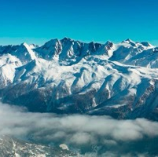

Examples of Multimodal Rumours and Non-Rumours
Image | Text | Label
 | BREAKING: Germanwings airplane crashes in French Alps with 142 passengers. | Rumour
 | call me foolish but this girl holding #JeSuisCharlie hiding her face, in a ghostly looking #Aleppo #Syria made me cry | Non-Rumour

Slide 29

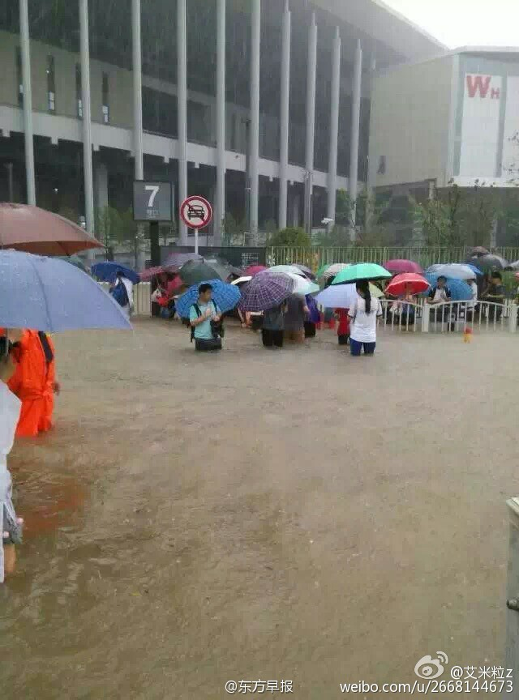
Examples of Multimodal Rumours and Non-Rumours
Image | Text | Label
 | 紧急通知！紧急通知！经辽宁省地震局公布，于2015年8月4日，15：30时左右鞍山，海城，盘锦，营口地区会出现5.8级地震 (emegency notice! emegency notice! According to the Liaoning Provincial Seismological Bureau, an earthquake with a magnitude of 5.8 will occur in Anshan, Haicheng, Panjin, and Yingkou areas around 15:30 on August 4, 2015.) | Rumour
 | 今早，暴雨、防汛防台均橙色预警，目前，闵行、青浦、普陀等多处已“见海”。 (This morning, orange warnings were issued for heavy rain and flood control. At present, the sea has already appeared in Minhang, Qingpu, Putuo and other places.) | Non-Rumour

Slide 30
II. User-Aware Rumour Detection
[4] T. Cheung and K. Lam, “Author-Aware Rumour Detection with Layer-Wise Parameter-Efficient Tuning and Incomplete Feature Learning,” submitted to IEEE Access.

Slide 31
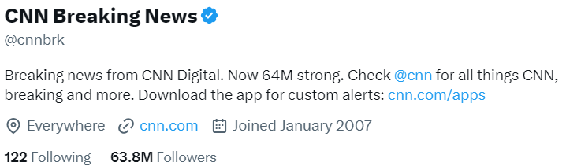
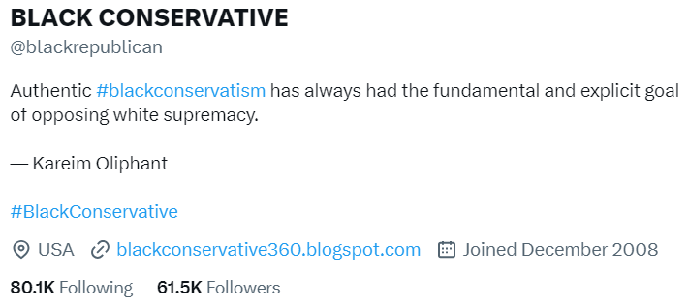
Challenges in Existing Rumor Detection Methods
Challenges
Current rumour detection methods often hinge on insights from user comments and other social media metrics.
Delay in the detection process arise due to the lagging nature of crowd signals.
Solution
User profiling provides useful credibility signal to distinguish malicious behaviors, such as spreading misinformation on social media.
Notes:
(a)
(b)

Slide 32
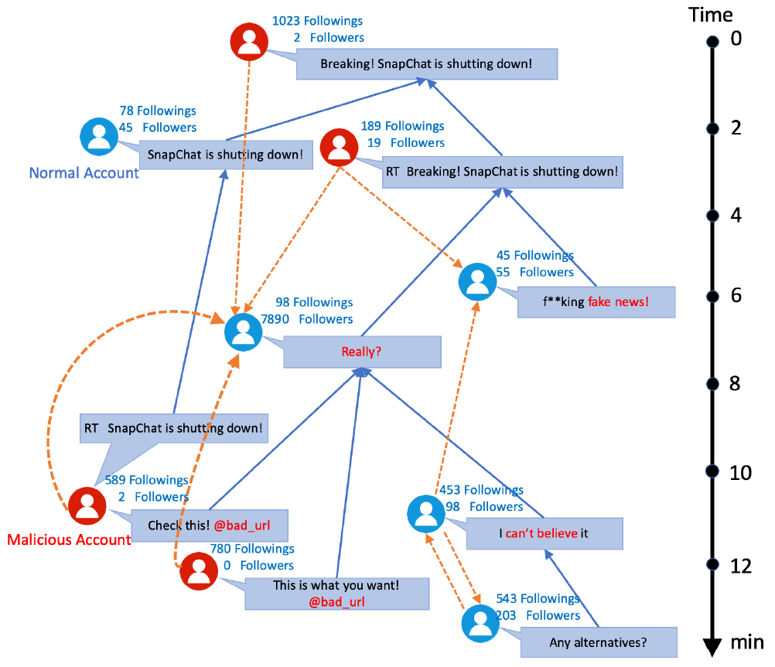
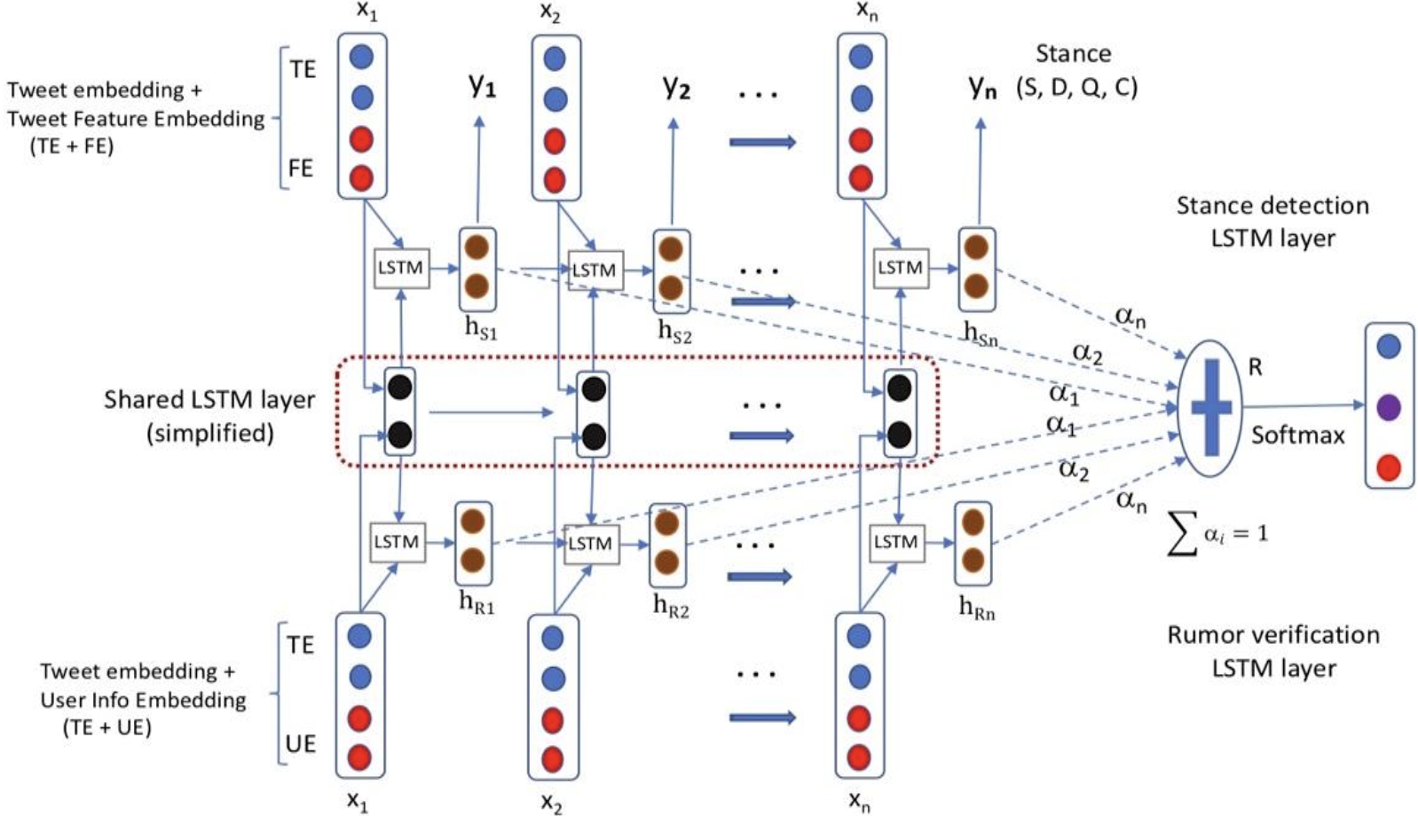
Limitation in Existing Author-Aware Approches
Inefficiency in utilizing Pretrained Models
Delayed crowed signal in utilizing social network relationship.

Slide 33
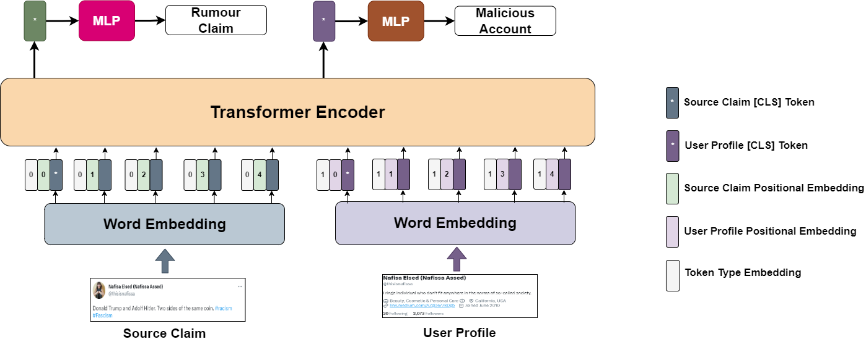
Author-Aware Rumour Detection Framework
Tuning Pretrained Transformer Encoder for Author-Aware Rumour Detection
Our goal is to fine-tune a Transformer encoder that accepts both source claim and user profile, for author-aware rumour detection.

Slide 34
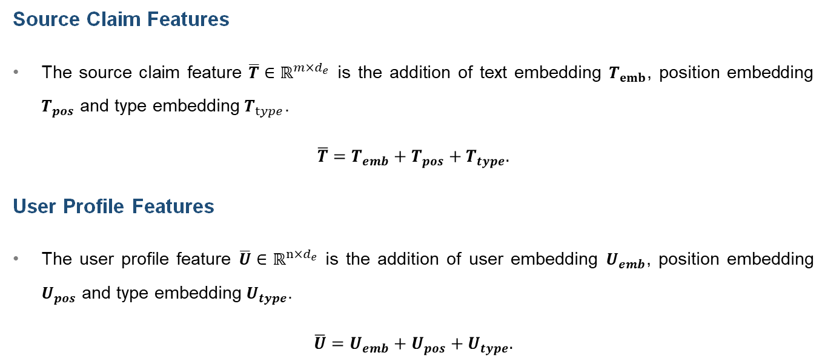
Tokenization and Input Embeddings
Source Claim Features
The source claim feature $\overline{T}∈ℝ^{m×d_{e}}$ is the addition of text embedding $T_{emb}$, position embedding $T_{pos}$ and type embedding $T_{type}$.
$$\overline{T}=T_{emb}+T_{pos}+T_{type}.$$
User Profile Features
The user profile feature $\overline{U}∈ℝ^{n×d_{e}}$ is the addition of user embedding $U_{emb}$, position embedding $U_{pos}$ and type embedding $U_{type}$.
$$\overline{U}=U_{emb}+U_{pos}+U_{type}.$$

Slide 35
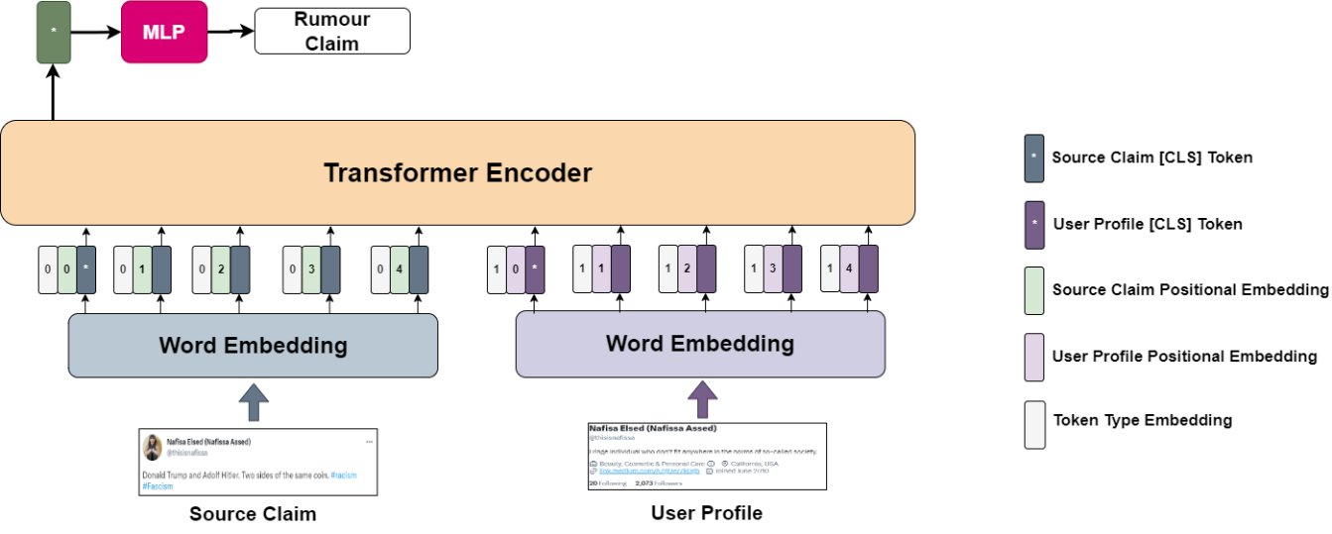
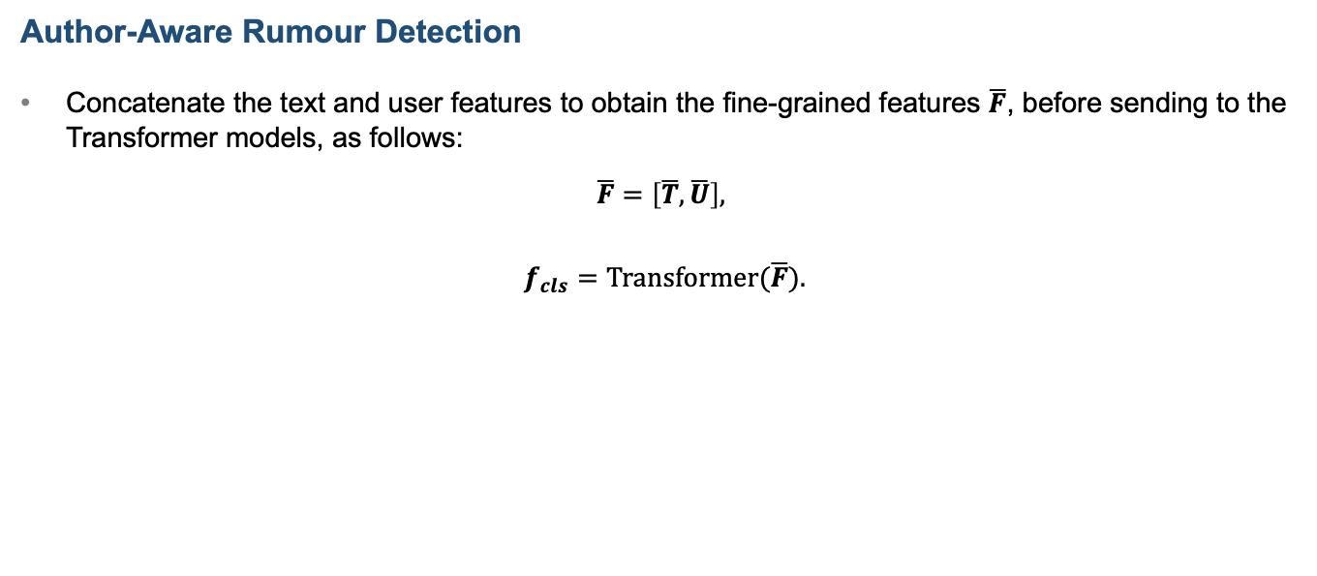
Author-Aware Rumour Detection
Author-Aware Rumour Detection
Concatenate the text and user features to obtain the fine-grained features $\overline{F}$, before sending to the Transformer models, as follows:
$$\overline{F}=\left[\overline{T},\overline{U}\right],$$
$f_{cls}=Transformer(\overline{F}).$

Slide 36
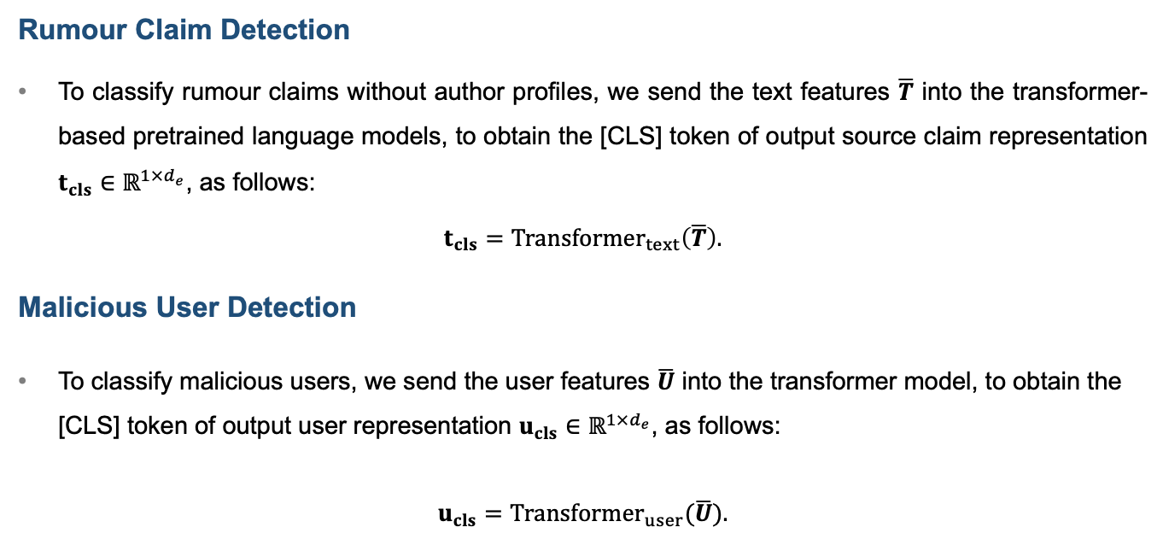
Multi-Task Transformer with Missing Features
Rumour Claim Detection
To classify rumour claims without author profiles, we send the text features $\overline{T}$ into the transformer-based pretrained language models, to obtain the [CLS] token of output source claim representation $t_{cls}∈ℝ^{1×d_{e}}$, as follows:
$$t_{cls}={Transformer}_{text}\left(\overline{T}\right).$$
Malicious User Detection
To classify malicious users, we send the user features $\overline{U}$ into the transformer model, to obtain the [CLS] token of output user representation $u_{cls}∈ℝ^{1×d_{e}}$, as follows:
$u_{cls}={Transformer}_{user}(\overline{U}).$

Slide 37
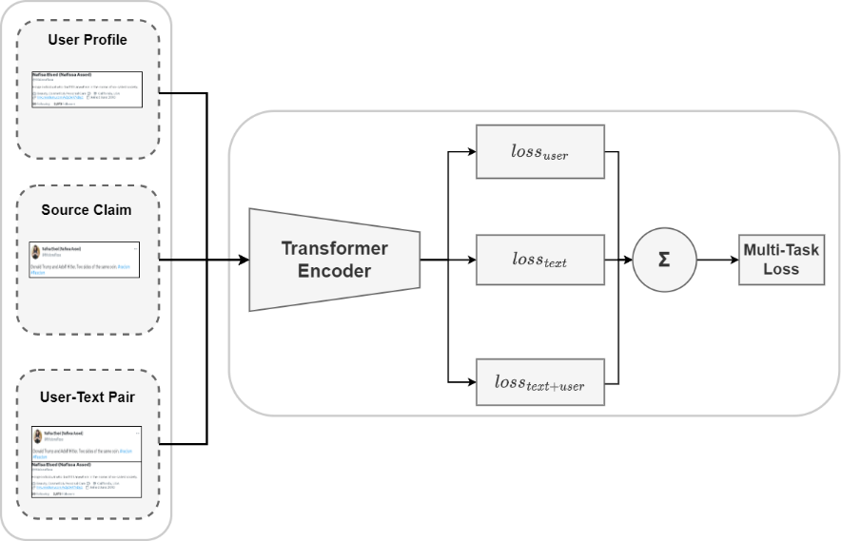
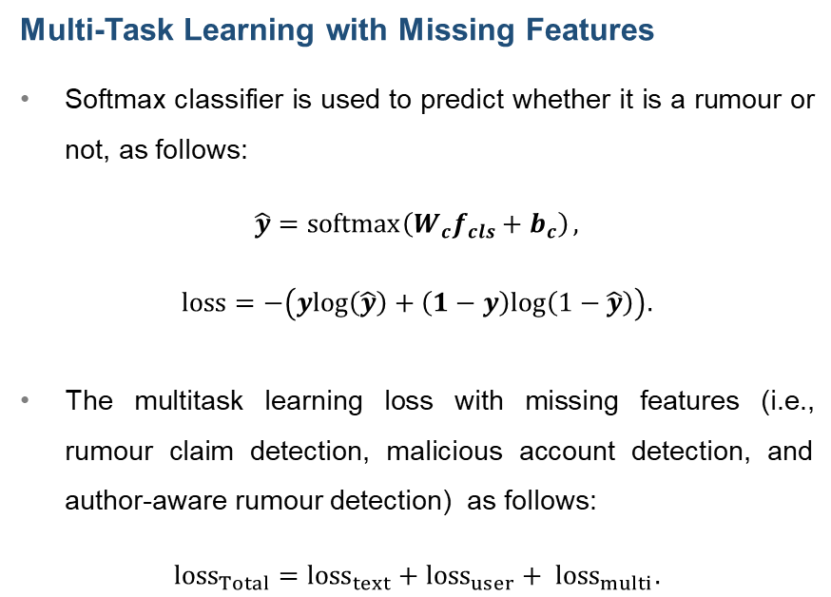
Multi-Task Loss with Missing Features
Multi-Task Learning with Missing Features
Softmax classifier is used to predict whether it is a rumour or not, as follows:
$$\hat{y}=\operatorname{softmax}\left(W_{c}f_{cls}+b_{c}\right),$$
$$loss=−\left(ylog\left(\hat{y}\right)+\left(1−y\right)log\left(1−\hat{y}\right)\right).$$
The multitask learning loss with missing features (i.e., rumour claim detection, malicious account detection, and author-aware rumour detection) as follows:
$${loss}_{Total}={loss}_{text}+{loss}_{user}+ {loss}_{multi}.$$

Slide 38
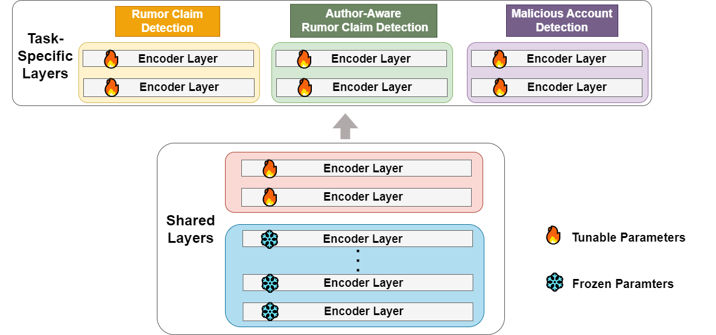
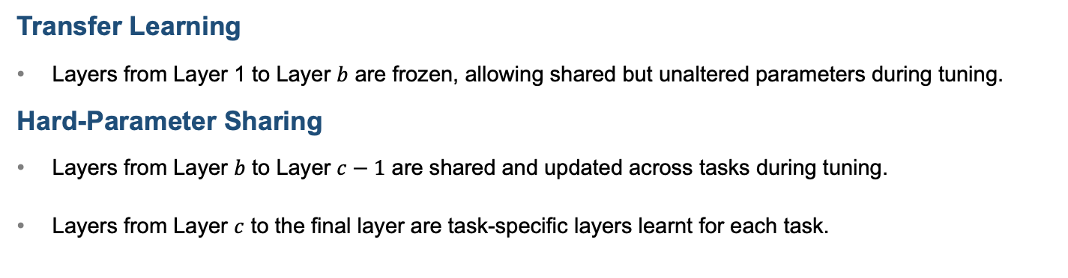
Layer-Wise Parameter-Efficient Tuning (LWPEF)
Transfer Learning
Layers from Layer 1 to Layer $b$ are frozen, allowing shared but unaltered parameters during tuning.
Hard-Parameter Sharing
Layers from Layer $b$ to Layer $c−1$ are shared and updated across tasks during tuning.
Layers from Layer $c$ to the final layer are task-specific layers learnt for each task.

Slide 39
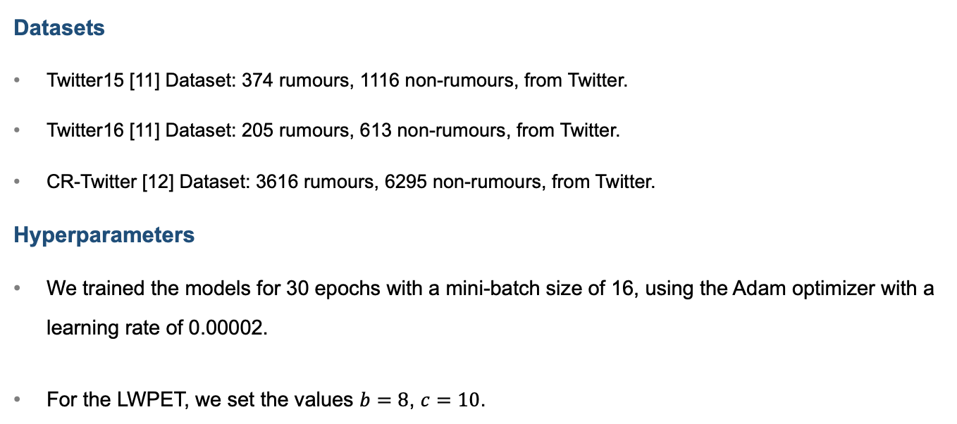
Experimental Details
Datasets
Twitter15 [11] Dataset: 374 rumours, 1116 non-rumours, from Twitter.
Twitter16 [11] Dataset: 205 rumours, 613 non-rumours, from Twitter.
CR-Twitter [12] Dataset: 3616 rumours, 6295 non-rumours, from Twitter.
Hyperparameters
We trained the models for 30 epochs with a mini-batch size of 16, using the Adam optimizer with a learning rate of 0.00002.
For the LWPET, we set the values $b=8$, $c=10$.
[11] Ma et al., “rumour Detection on Twitter with Tree-structured Recursive Neural Networks,” ACL,” 2018.
[12] Chen et al., “Identifying Cantonese rumors with discriminative feature integration in online social networks,” Expert Systems with Applications, 2023.

Slide 40
Results on Twitter15, Twitter16, and CR-Twitter Datasets
Dataset | Method | Author Profile Injection | Macro-F1 | Accuracy
Twitter15 | BERT | ✕ | 0.8505 | 0.8814
 |  | ✓ | 0.9413 | 0.9526
 | RoBERTa | ✕ | 0.8985 | 0.9170
 |  | ✓ | 0.9366 | 0.9486
 | DistilBERT | ✕ | 0.8472 | 0.8735
 |  | ✓ | 0.9372 | 0.9486
 | DeBERTa | ✕ | 0.8958 | 0.9130
 |  | ✓ | 0.9016 | 0.9170
Twitter16 | BERT | ✕ | 0.8328 | 0.8702
 |  | ✓ | 0.9270 | 0.9389
 | RoBERTa | ✕ | 0.8358 | 0.8702
 |  | ✓ | 0.8888 | 0.9084
 | DistilBERT | ✕ | 0.8440 | 0.8779
 |  | ✓ | 0.9073 | 0.9237
 | DeBERTa | ✕ | 0.8085 | 0.8473
 |  | ✓ | 0.8786 | 0.9008
CR-Twitter | BERT | ✕ | 0.7996 | 0.8134
 |  | ✓ | 0.8302 | 0.8411
 | RoBERTa | ✕ | 0.7927 | 0.8103
 |  | ✓ | 0.8174 | 0.8282

Slide 41
Ablation studies on Author-Aware Rumour Detection
Dataset | Model | Macro-F1 | Accuracy
Twitter-15 | Ours w/o user profiling | 0.8505 | 0.8814
 | Ours w/o multi-task learning | 0.9236 | 0.9368
 | Ours (Full) | 0.9413 | 0.9526
Twitter-16 | Ours w/o user profiling | 0.8328 | 0.8702
 | Ours w/o multi-task learning | 0.8988 | 0.9160
 | Ours (Full) | 0.9270 | 0.9389
CR-Twitter | Ours w/o user profiling | 0.7996 | 0.8134
 | Ours w/o multi-task learning | 0.8162 | 0.8288
 | Ours (Full) | 0.8302 | 0.8411

Slide 42
Different Fusion Strategies
Dataset | Fusion Strategies | Macro-F1 | Accuracy
Twitter-15 | Feature concatenation in output feature | 0.8968 | 0.9170
 | Score aggregation in output logit | 0.8737 | 0.9012
 | Token concatenation in input embedding | 0.9236 | 0.9368
Twitter-16 | Feature concatenation in output feature | 0.8085 | 0.8473
 | Score aggregation in output logit | 0.8468 | 0.8779
 | Token concatenation in input embedding | 0.8988 | 0.9160
CR-Twitter | Feature concatenation in the output feature | 0.7964 | 0.8159
 | Score aggregation in output logit | 0.7948 | 0.8159
 | Token concatenation in input embedding | 0.8162 | 0.8288

Slide 43
Different Tuning Strategies
Dataset | Tuning Strategy | Macro-F1 | Accuracy
Twitter-15 | Fine-Tuning [41] | 0.9040 | 0.9249
 | Adapter-Tuning with Bottleneck [71] | 0.8753 | 0.8933
 | Adapter-Tuning with LORA [72] | 0.8376 | 0.8656
 | Prefix-Tuning [73] | 0.8623 | 0.8933
 | Layer-Wise Parameter-Efficient Tuning (Ours) | 0.9413 | 0.9526
Twitter-16 | Fine-Tuning [41] | 0.9270 | 0.9389
 | Adapter-Tuning with Bottleneck | 0.8641 | 0.8855
 | Adapter-Tuning with LORA [72] | 0.7694 | 0.8244
 | Prompt-Tuning [73] | 0.7585 | 0.8092
 | Layer-Wise Parameter-Efficient Tuning (Ours) | 0.9270 | 0.9389
CR-Twitter | Fine-Tuning [41] | 0.8050 | 0.8153
 | Adapter-Tuning with Bottleneck [71] | 0.8017 | 0.8147
 | Adapter-Tuning with LORA [72] | 0.7858 | 0.8023
 | Prompt-Tuning [73] | 0.7912 | 0.8073
 | Layer-Wise Parameter-Efficient Tuning (Ours) | 0.8302 | 0.8411

Slide 44
Examples of Rumour and Non-rumour
 | Text | User | Label
(a) | Hillary Clinton is lying. Clinton is NOT the first woman nominated for president. | Just google me. It's pretty funny. | Rumour
(b) | Doctors should screen all adults for depression at least once, the task force recommends. | Breaking news from CNN Digital. | Non-Rumour
(c) | 福建晉江某人隱瞞武漢旅行史，過年期間活躍出席當地各種公開活動和宴席，導致3-4千人需要被監控。 (A person in Jinjiang, Fujian concealed his travel history to Wuhan, and actively attended various local public events and banquets during the Chinese New Year, resulting in 3-4 thousand people needing to be monitored.) | RFA自由亞洲電台政治漫畫家/個人言論与RFA公司立場無關 (RFA Radio Free Asia political cartoonist/personal remarks have nothing to do with RFA's position) | Rumour
(d) | 林鄭月娥由上海轉往南京 ，出席第二屆蘇港融合發展峰會，並與江蘇省領導會面，又與港商交流。 (Carrie Lam transferred from Shanghai to Nanjing to attend the 2nd Suzhou-Hong Kong Integration Development Summit, met with leaders of Jiangsu Province, and communicated with Hong Kong businessmen.) | 香港特區政府網上新聞平台 (Hong Kong SAR Government Online News Platform) | Non-Rumour

Slide 45
III. Stream Verification of Online rumours using Community Response
[5] T. Cheung and K. Lam, “Causal diffused graph-transformer network with stacked early classification loss for efficient stream classification of rumours,” Knowledge-Based Systems, vol. 277, pp. 110807, 2023.

Slide 46
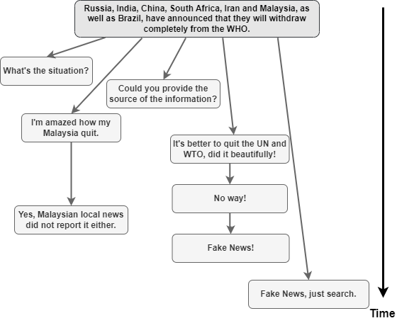
Stream Verification of Online Rumours
Community Response
Online social media platforms allow users to quote and reply to a source post or a reply. The propagation graph evolves along time.

Slide 47
Limitation of Existing Approches
Graph Neural Networks (GNNs) and Transformers
GNNs model social media propagation patterns.
Transformers capture sequential source-to-reply relationships.
Both networks show promising rumour classification performance.
Non-Causal Efficiency Challenge
Non-causal nature hinders efficiency in stream mining.
Features from a reply depend on future replies, impacting real-time verification.

Slide 48
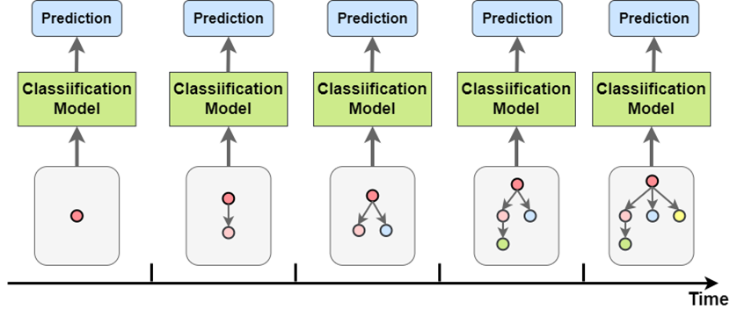
Stream Verification of rumours
Early stream verification of rumours is to instantly determine the veracity of the source post, whenever a reply is posted, favourably when the number of replies is small in the early stage of propagation.

Slide 49
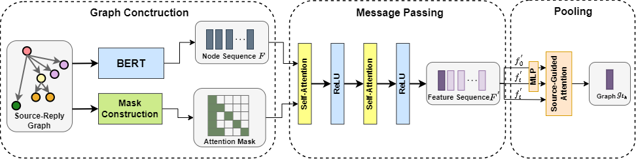
Causal Diffused Graph-Transformer Network (CDGTN)
Graph Construction: Construct the source-reply graph by obtaining the node features and graph connectivity mask.
Message Passing: Aggregate information from its local neighborhood
Pooling: Aggregate the node features into the graph representation.

Slide 50
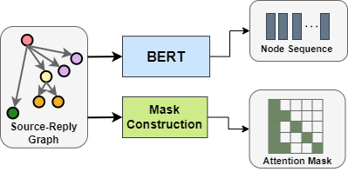
Casual Dffused Graph-Transformer Network
Node Feature Matrix
BERT is used to project each tweet into a fix-length representation. The hidden representation of the [CLS] token is used as the representation for each tweet.
Edge Connectivity Matrix
Forces the query not to attend to the key and value vectors in future positions.
Compute the attention scores that belong to the path of positions from the source post to the latest reply.

Slide 51
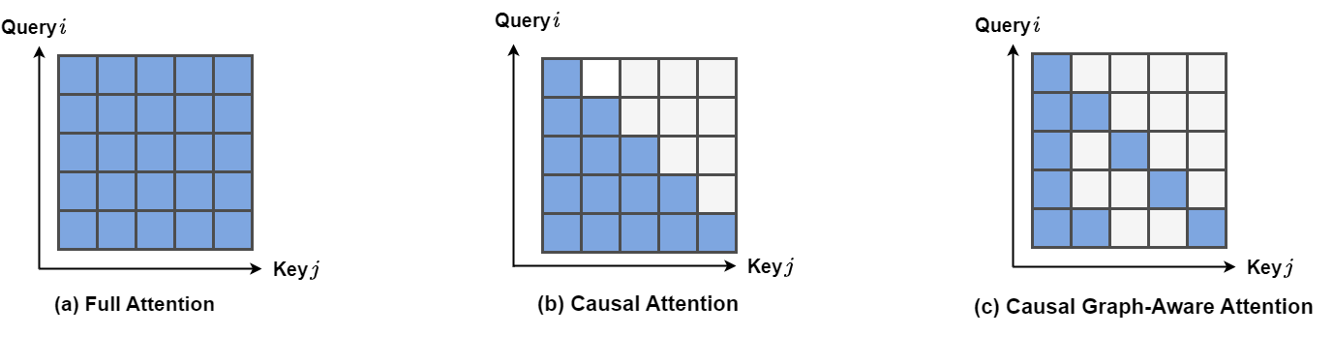
Illustration of Attention Mask
Causal Graph-Aware Attention Mask
Force the query not to attend to the key and value vectors in future positions.
Compute the attention scores that belong to the path of positions from the source post to the latest reply.

Slide 52
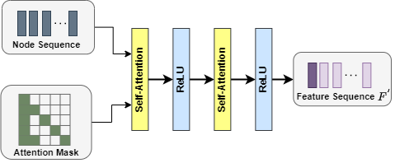
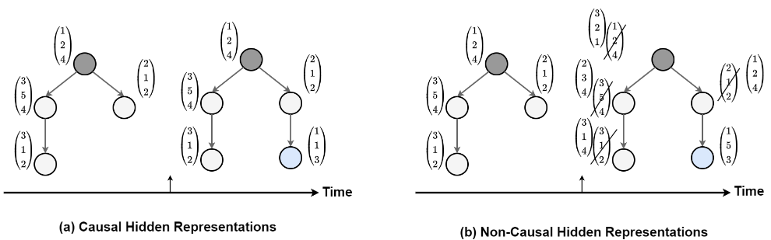
Message Passing and Causal Representations
Message Passing
We use a two-layer Transformer encoder to model a message and the corresponding nodes all the way to the source post.
Causal Hidden Representations
Due to the nature of the proposed attention mask, the hidden representations of the graph is causal.

Slide 53
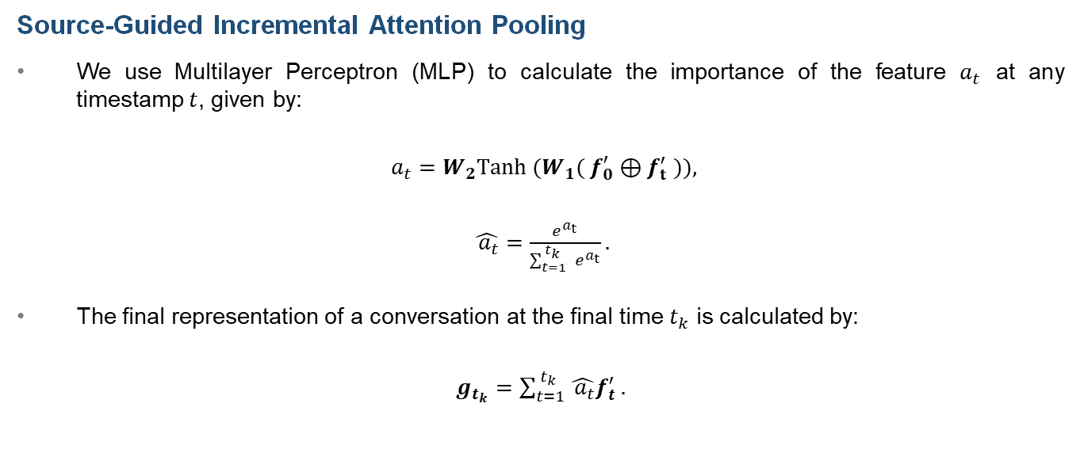
Source-Guided Incremental Attention Pooling
Source-Guided Incremental Attention Pooling
We use Multilayer Perceptron (MLP) to calculate the importance of the feature $a_{t}$ at any timestamp $t$, given by:
$a_{t}=W_{2}Tanh (W_{1}( f_{0}^{′}⊕f_{t}^{′} )),$
$\hat{ a_{t}}=\frac{e^{a_{t}}}{\sum_{t=1}^{ t_{k}}{ e^{a_{t}}}}.$
The final representation of a conversation at the final time $t_{k}$ is calculated by:
$g_{t_{k}}=\sum_{t=1}^{ t_{k}}{\hat{ a_{t}}f_{t}^{′}}.$

Slide 54
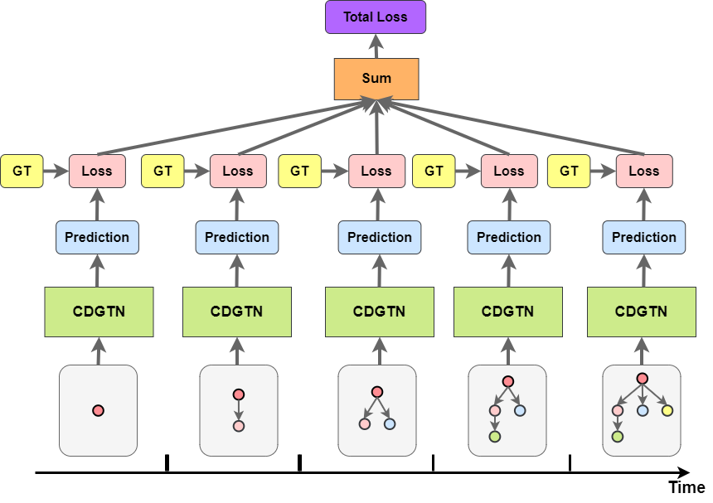
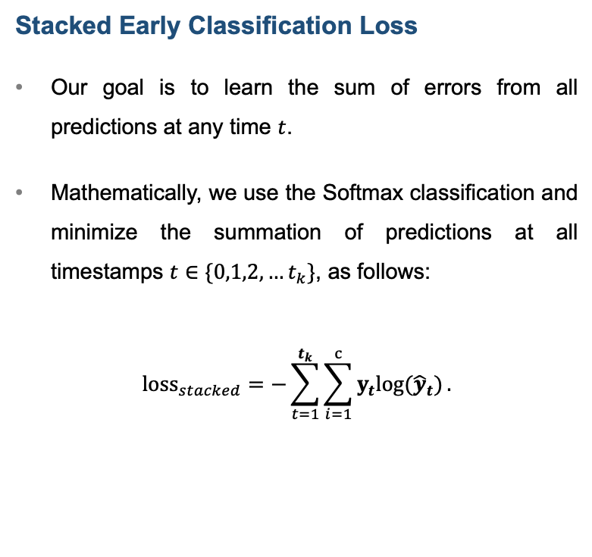
Illustration of Stacked Early Classification Loss (SecLoss)
Stacked Early Classification Loss
Our goal is to learn the sum of errors from all predictions at any time $t$.
Mathematically, we use the Softmax classification and minimize the summation of predictions at all timestamps $t∈\{0,1,2,…t_{k}\}$, as follows:
$${loss}_{stacked}=−\sum_{t=1}^{t_{k}}{\sum_{i=1}^{c}{y_{t}log⁡({\hat{y}}_{t})}}.$$

Slide 55
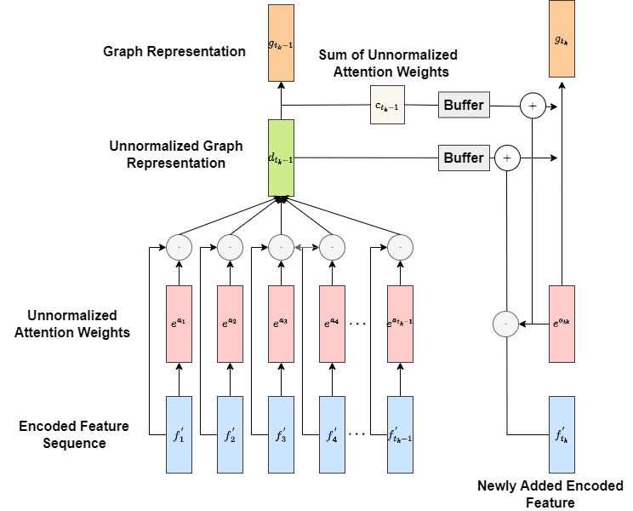

Continue Inference Framework with Buffering
Continue Inference
By buffering the running total of the unnormalized weighted features $c_{t_{k}−1}$ and sum of the unnormalized attention weights $d_{t_{k}−1}$at time $t_{k−1}$, we compute the total sum of the feature vectors at the time $t_{k}$ as follows:
$$c_{t_{k}}=c_{t_{k−1}}+ e^{a_{t_{k}}}f_{ t_{k}}^{′},$$
$d_{t_{k}}=d_{t_{k}−1}+ e^{a_{t_{k}}}.$
In this way, we avoid the redundant calculation of the features and weights from time 1 to $t_{k}−1$.

Slide 56
Experimental Details
Datasets
Twitter15 [11]: 374 unverified-rumours, 372 true-rumours, 370 false-rumours, 373 non-rumours
Twitter16 [11] : 201 unverified-rumours, 207 true-rumours, 205 false-rumours, 205 non-rumours
CR-Twitter [13]: 143 unverified-rumours, 303 true-rumours, 405 false-rumours, 1334 non-rumours
Hyperparameters
We trained the models for 50 epochs with a mini-batch size of 16, which is the largest multiple of 2 that fits the GPU memory in the experiment setup.
We employ Adam optimizer with an initial learning rate of 2e-5 and a linear learning decay from the initial value to 0.
[11] Ma et al., “Rumour Detection on Twitter with Tree-structured Recursive Neural Networks,” ACL,” 2018.
[13] Ke et al., “Novel Approach for Cantonese Rumour Detection based on Deep Neural Network,” IEEE SMC, 2020.

Slide 57
Rumour Verification Results on Twitter15 Dataset
Model | Accuracy | F1 (Macro) | F1 (NR) | F1 (FR) | F1 (TR) | F1 (UR)
DTC [81] | 0.454 | 0.455 | 0.733 | 0.355 | 0.317 | 0.415
SVM-TS [42] | 0.544 | 0.539 | 0.796 | 0.472 | 0.404 | 0.483
GRU-RNN [28] | 0.641 | 0.644 | 0.684 | 0.634 | 0.688 | 0.571
BU-RvNN [24] | 0.708 | 0.709 | 0.695 | 0.728 | 0.759 | 0.653
TD-RvNN [24] | 0.723 | 0.729 | 0.682 | 0.758 | 0.821 | 0.654
STS-NN [25] | 0.809 | 0.809 | 0.797 | 0.811 | 0.856 | 0.773
PLAN [82] | 0.845 | 0.845 | 0.823 | 0.858 | 0.895 | 0.802
StA-PLAN [82] | 0.852 | 0.852 | 0.840 | 0.846 | 0.884 | 0.837
Bi-GCN [27] | 0.886 | 0.886 | 0.891 | 0.860 | 0.93 | 0.864
PPA-WAE[83] | 0.873 | 0.873 | 0.899 | 0.881 | 0.869 | 0.843
DA-GCN [84] | 0.905 | 0.905 | 0.959 | 0.895 | 0.914 | 0.852
GACL [85] | 0.901 | 0.897 | 0.958 | 0.851 | 0.903 | 0.876
CDGTN | 0.916 | 0.915 | 0.947 | 0.951 | 0.912 | 0.859
NR: Non-Rumour TR: True-Rumour
FR: False-Rumour UR: Unverified-Rumour

Slide 58
Rumour Verification Results on Twitter16 Dataset
Model | Accuracy | F1 (Macro) | F1 (NR) | F1 (FR) | F1 (TR) | F1 (UR)
DTC [81] | 0.465 | 0.465 | 0.643 | 0.393 | 0.419 | 0.403
SVM-TS [42] | 0.574 | 0.568 | 0.755 | 0.420 | 0.571 | 0.526
GRU-RNN [28] | 0.633 | 0.609 | 0.617 | 0.715 | 0.577 | 0.527
BU-RvNN [24] | 0.718 | 0.718 | 0.723 | 0.712 | 0.779 | 0.659
TD-RvNN [24] | 0.737 | 0.737 | 0.662 | 0.743 | 0.835 | 0.708
STS-NN [25] | 0.809 | 0.809 | 0.797 | 0.811 | 0.856 | 0.773
PLAN [82] | 0.874 | 0.874 | 0.853 | 0.839 | 0.917 | 0.888
StA-PLAN [82] | 0.868 | 0.869 | 0.826 | 0.833 | 0.927 | 0.888
Bi-GCN [27] | 0.880 | 0.880 | 0.847 | 0.869 | 0.937 | 0.865
PPA-WAE[83] | 0.887 | 0.887 | 0.882 | 0.903 | 0.921 | 0.842
DA-GCN [84] | 0.902 | 0.902 | 0.894 | 0.872 | 0.928 | 0.913
GACL [85] | 0.920 | 0.917 | 0.934 | 0.869 | 0.959 | 0.907
CDGTN | 0.929 | 0.927 | 0.874 | 0.949 | 0.956 | 0.931
NR: Non-Rumour TR: True-Rumour
FR: False-Rumour UR: Unverified-Rumour

Slide 59
Rumour Verification Results on CR-Twitter Dataset
Model | Accuracy | F1 (Macro) | F1 (NR) | F1 (FR) | F1 (TR) | F1 (UR)
RNN-GRU [28] | 0.841 | 0.778 | 0.903 | 0.744 | 0.726 | 0.739
PLAN [82] | 0.855 | 0.790 | 0.916 | 0.766 | 0.702 | 0.778
GNN-LSTM [86] | 0.855 | 0.721 | 0.928 | 0.765 | 0.790 | 0.400
GAT [87] | 0.871 | 0.825 | 0.922 | 0.772 | 0.815 | 0.793
GCN [27] | 0.841 | 0.757 | 0.911 | 0.770 | 0.667 | 0.682
Bi-GCN [27] | 0.867 | 0.808 | 0.919 | 0.797 | 0.734 | 0.783
GACL [85] | 0.880 | 0.825 | 0.935 | 0.813 | 0.760 | 0.792
DCNF [88] | 0.880 | 0.826 | 0.930 | 0.826 | 0.739 | 0.809
CDGTN | 0.891 | 0.858 | 0.931 | 0.824 | 0.805 | 0.873
NR: Non-Rumour TR: True-Rumour
FR: False-Rumour UR: Unverified-Rumour

Slide 60
Ablation Study on CDGTN
Dataset | Model | Accuracy | F1 (Macro)
Twitter15 | CDGTN w/o attention mask | 0.909 | 0.908
 | CDGTN w/o SGIAP | 0.882 | 0.881
 | CDGTN (Full) | 0.912 | 0.912
Twitter16 | CDGTN w/o attention mask | 0.933 | 0.932
 | CDGTN w/o SGIAP | 0.926 | 0.926
 | CDGTN (Full) | 0.939 | 0.939
CR-Twitter | CDGTN w/o attention mask | 0.818 | 0.750
 | CDGTN w/o SGIAP | 0.878 | 0.820
 | CDGTN (Full) | 0.891 | 0.858

Slide 61


Early Rumour Classification Results on Twitter Datasets
Our Method
Our Method
Twitter15 Dataset
Twitter16 Dataset

Slide 62

Early Rumour Classification Results on CR-Twitter Dataset
Our Method

Slide 63

Time Complexity Analysis of Stream Verification
Our Method

Slide 64
Examples on CR-Twitter Dataset
Label | Message
False Rumour | Source | Large-scale protest in Hunan, China
 | Replies | Please give a news link, thank you.
 |  | Impossible, absolutely impossible.
 |  | You idiot. See it clearly, don't spread fake news.
 |  | This kind of fake account is not serious.
True Rumour | Source | Playing baseball in a Power failure.
 | Replies | This is so funny.
 |  | Does everyone wear night vision goggles?
 |  | The Uni-President Lions still played today, but Su Zhijie lost power halfway through the game.
 |  | I laughed so hard yesterday when watching the live.
Unverified Rumour | Source | At 4 a.m., a fire broke out in a community in Yibin, Sichuan, and fire trucks came, but they couldn't get in, and the iron sheet of closure and control blocked it.
 | Replies | No casualties, right?
 |  | True or false?
 |  | Is it true?
 |  | It is going to spread rumours again.
Non-Rumour | Source | On August 22, Zheng Zhongwei, director of the Science and Technology Development Center of the National Health and Medical Commission and head of the Vaccine Research and Development Working Group of the Joint Prevention and Control Mechanism of the State Council, said in the CCTV "Dialogue" program that my country has officially launched the new crown vaccine on July 22. for emergency use.
 | Replies | Give the vaccine to African brothers first, they need it more.
 |  | Keep it up!
 |  | In China, epidemic prevention and control and vaccine research and development are so excellent that people feel safe and peaceful.
 |  | Pay tribute to the "rebels" all over the world and may the human disasters on the scene disappear.

Slide 65
IV. External Evidence-Based Claim Veracity Assessment using Large Language Models (LLMs)
[6] T. Cheung and K. Lam, “FactLLaMA: Optimizing Instruction-Following Language Models with External Knowledge for Automated Fact-Checking,” in Proceedings, APSIPA ASC 2023, Oct. 31, 2023.

Slide 66

Background
Background
The emergent Large Language Models (LLMs) has revolutionized the research field of Natural Language Processing (NLP) in 2023.
Contribution
We aim to examine the fact-checking capability of open-source LLMs, i.e., LLaMA [14,15], in terms of inherent knowledge, reasoning ability with external evidence, and comparison to the fine-tuned Small Language Models (SLMs) i.e., BERT.
BERT
Encoder-Only
LLaMA
Decoder-Only
[14] Touvron et al., “LLaMA: Open and Efficient Foundation Language Models.” arXiv, 2023.
[15] Touvron et al., “LLaMA 2: Open Foundation and Fine-Tuned Chat Models.” arXiv, 2023.

Slide 67

Research Questions
How does the effectiveness of fact-checking using LLMs compare between inherent knowledge and external knowledge utilization?
Does fine-tuning LLMs lead to superior fact-checking performance, and how does it compare between models with and without external knowledge?
In the context of fact-checking, how does the performance of LLaMA-based fine-tuning compare to BERT-based fine-tuning?

Slide 68

External Evidence-Based Claim Veracity Assessment
To improve the fact-checking capability, we adopt the Google Search API to retrieve relevant information to verify a statement.

Slide 69

Instruction-Tuning with External Evidence
Due to the limited computational power, we adopt Low Rank Adaption (LORA) [15] and 8-bit quantization [17] to fine-tune LLaMA with external evidence for automatic fact-checking.
[16] Hu et al. "LoRA: Low-Rank Adaptation of Large Language Models." Int. Conf. on Learning Representations. 2021.
[17] Dettmers et al. "Llm.int8(): 8-bit matrix multiplication for transformers at scale." NeurIPS, 2022.

Slide 70
Experimental Details
Implementation Details
LLaMA-7B [14] is used as the backbone model for fine-tuning.
LLaMA2-Chat-7B [15] is used for zero-shot prompting.
Hyperparameter | Value
Number of Epoch | 3
Mini-batch Size | 2 (with gradient accumulation 16x)
Optimizer | Adam Optimizer
Initial Learning rate | Linearly decay to 0
[14] Touvron et al., “LLaMA: Open and Efficient Foundation Language Models.” arXiv, 2023.
[15] Touvron et al., “LLaMA 2: Open Foundation and Fine-Tuned Chat Models.” arXiv, 2023.

Slide 71
Comparison to Other SOTA Methods
Methods | Precision | Recall | F1-Score
SVM [104] | 0.3233 | 0.3251 | 0.3171
CNN [101] | 0.3880 | 0.3850 | 0.3859
RNN [105] | 0.4135 | 0.4209 | 0.4039
DeClarE [106] | 0.4339 | 0.4352 | 0.4218
dEFEND [97] | 0.4493 | 0.4326 | 0.4407
sentHAN [107] | 0.4566 | 0.4554 | 0.4425
SBERT-FC [34] | 0.5106 | 0.4592 | 0.4551
GenFE [99] | 0.4429 | 0.4474 | 0.4443
GenFE-MT [99] | 0.4564 | 0.4527 | 0.4508
CofCED [98] | 0.5299 | 0.5099 | 0.5107
FactLLaMA | 0.5611 | 0.5550 | 0.5565

Slide 72
Fine-tuned vs Zero-Shot Prompt-Based Methods
Settings | Methods | Precision | Recall | F1
BERT-Based Fine-Tuning | SBERT-FC | 0.5106 | 0.4592 | 0.4551
 | GenFE | 0.4429 | 0.4474 | 0.4443
 | GenFE-MT | 0.4564 | 0.4527 | 0.4508
 | CofCED | 0.5299 | 0.5099 | 0.5107
LLaMA-Based Zero-Shot Prompting | LLaMA2-Chat* (w/o external knowledge) | 0.4198 | 0.4311 | 0.3775
 | LLaMA2-Chat* (with external knowledge) | 0.4881 | 0.4858 | 0.4793
LLaMA-Based Fine-Tuning | FactLLaMA (w/o external knowledge) | 0.5376 | 05400 | 0.5376
 | FactLLaMA (with external knowledge) | 0.5611 | 0.5550 | 0.5565
*Experiments with LLaMA2-Chat were done after submitting the thesis.

Slide 73
Examples of External Evidence-Based Fact-Checking
Label | Text
False | Source | An ISIS flag is being displayed in the window of a café under siege in Sydney’s Martin Place.
 | External Evidence | The flag displayed during the siege at a Sydney cafe is not the same one used by the Islamic State terrorist group.
 |  | The black flag with white writing hung in the window was initially mistaken by many for an Isis flag.
 |  | Siege makes global headlines. The flag shown being held by hostages against the window of Lindt Chocolat Cafe is not an Islamic State flag but an Islamic flag that has been co-opted.
True | Source | Germanwings Airbus A320 crashes in French Alps
 | External Evidence | Germanwings A320 aircraft flying from Barcelona to Düsseldorf goes down in southern French Alps with 150 on board ... German Airbus A320 plane crashes in French Alps.
 |  | A Germanwings plane carrying 150 people has crashed in the French Alps on its way from Barcelona to Duesseldorf. The Airbus A320 - flight 4U 9525 - went down between Digne and Barcelonnette.
 |  | An Airbus A320 with 144 passengers and 6 crew members has crashed in Digne region.

Slide 74
Summary
RQ1: External Knowledge Boost
Incorporating external knowledge improves LLM-based fact-checking performance. LLaMA2-Chat with external knowledge enhances overall effectiveness.
RQ2: Fine-Tuning Success
Fine-tuning LLMs, especially with external knowledge, boosts fact-checking performance. Fine-tuned FactLLaMA demonstrates heightened effectiveness.
RQ3: Fine-tuned LLaMA beats Fine-tuned BERT
LLaMA-based fine-tuning excels in fact-checking over BERT, showcasing superior performance. FactLLaMA outperforms SBERT-FC in overall effectiveness.

Slide 75
Conclusion and Future Work

Slide 76
Comparison of Different Methods
Method | Advantages | Disadvantages
Multimodal Image-Text Rumour Detection | Comprehensive understanding with text and visual integration. | Reliable labeled dataset needed for training.
 | Deep learning with crossmodal attention macahsim captures complex patterns. | Dependency on image availability and quality.
Simultaneous Rumour and Malicious Account Detection | Early detection approach to find misleading information. | Identification may require additional metadata.
 | User Profiling in identifying accounts. | Overreliance on behavior patterns may lead to false results.
Propagation Graph-Based Claim Veracity on Social Media | Graph-based approach captures spread and propagation patterns. | Constructing the holistic propagation graphs is computationally expensive.
 | Incorporation of community enhances veracity assessment. | Rely on availability and latency of network and community response.
Claim Veracity Assessment using External Evidence | External evidence provided for broader perspective. | Reliability of external sources and fact-checking reports may vary.
 | Access to fact-checking reports and expert opinions improves reliability. | Challenge of effectively integrating diverse evidence.

Slide 77
Conclusion
Holistic Investigation for Rumour Detection and Veracity Assessment
Innovative approaches, including multimodal image-text classification, author-aware rumour detection, propagation graph-based analysis, and external evidence-based claim veracity assessment.
Addressing Challenges in Misinformation
Addressing challenges posed by rumours and false information, showcasing the potential for positive impacts on individuals, society, and the overall information ecosystem.
Call for Future Research and Ethical Considerations
Encourage future research, such as LLMs, to build upon these findings, considering emerging trends and ethical considerations.

Slide 78

Future Work
Multimodal Fake Video Detection. Extend the proposed methods to video-sharing platforms, such as YouTube [18], TikTok [19], and DouYin [20], using audio, video, voice-to-text features.
[18] H. Choi and Y. Ko, “Using Topic Modeling and Adversarial Neural Networks for Fake News Video Detection,” CIKM, 2021.
[19] Shang et al., "A Multimodal Misinformation Detector for COVID-19 Short Videos on TikTok," IEEE Int. Conf.on Big Data2021, pp. 899-908 .
[20] Qi et al., “FakeSV: A Multimodal Benchmark with Rich Social Context for Fake News Detection on Short Video Platforms,”, AAAI, vol. 37, no. 12, pp. 14444–14452, Jun. 26, 2023.

Slide 79

Future Work
Hallucination Detection. Address the problem of LLM-Generated Misinformation.
[21] C. Chen and K. Shu, “Combating Misinformation in the Age of LLMs: Opportunities and Challenges.” arXiv, 2023.

Slide 80
References
[1] Rohera et al., “A Taxonomy of Fake News Classification Techniques: Survey and Implementation Aspects,” IEEE Access, vol. 10, 2022.
[2] Zubiaga et al., “Detection and Resolution of Rumours in Social Media,” ACM Computing Surveys, vol. 51, no. 2, pp. 1–36, 2018.
[3] T. Cheung and K. Lam, “Crossmodal bipolar attention for multimodal classification on social media,” Neurocomputing, vol. 514, pp. 1–12, Dec. 2022.
[4] T. Cheung and K. Lam, “Author-Aware Rumour Detection with Layer-Wise Parameter-Efficient Tuning and Incomplete Feature Learning,” submitted to IEEE Access.
[5] T. Cheung and K. Lam, “Causal diffused graph-transformer network with stacked early classification loss for efficient stream classification of rumours,” Knowledge-Based Systems, vol. 277, pp. 110807, 2023.
[6] T. Cheung and K. Lam, “FactLLaMA: Optimizing Instruction-Following Language Models with External Knowledge for Automated Fact-Checking,” in Proceedings, APSIPA ASC 2023, Oct. 31, 2023.
[7] Dosovitskiy et al., “An Image is Worth 16x16 Words: Transformers for Image Recognition at Scale,” in ICLR, 2021.
[8] Devlin et al., “BERT: Pre-training of deep bidirectional transformers for language understanding,” in NAACL, 2019.
[9] Augbiaga et al., “Exploiting Context for Rumour Detection in Social Media,” International Conference on Social Informatics,” 2017.
[10] Jin et al., “Multimodal Fusion with Recurrent Neural Networks for Rumour Detection on Microblogs,” ACM MM, 2017.

Slide 81
References
[11] Ma et al., “Rumour Detection on Twitter with Tree-structured Recursive Neural Networks,” ACL,” 2018.
[12] Chen et al., “Identifying Cantonese rumors with discriminative feature integration in online social networks,” Expert Systems with Applications, 2023.
[13] Ke et al., “Novel Approach for Cantonese Rumour Detection based on Deep Neural Network,” IEEE SMC, 2020.
[14] Touvron et al., “LLaMA: Open and Efficient Foundation Language Models.” arXiv, 2023.
[15] Touvron et al., “LLaMA 2: Open Foundation and Fine-Tuned Chat Models.” arXiv, 2023.
[16] Hu et al. "LoRA: Low-Rank Adaptation of Large Language Models." International Conference on Learning Representations. 2021.
[17] Dettmers et al. "Llm. int8 (): 8-bit matrix multiplication for transformers at scale." NeurIPS, 2022.
[18] H. Choi and Y. Ko, “Using Topic Modeling and Adversarial Neural Networks for Fake News Video Detection,” CIKM, 2021.
[19] Shang et al., "A Multimodal Misinformation Detector for COVID-19 Short Videos on TikTok," IEEE International Conference on Big Data (Big Data), 2021, pp. 899-908 .
[20] Qi et al., “FakeSV: A Multimodal Benchmark with Rich Social Context for Fake News Detection on Short Video Platforms,”, AAAI, vol. 37, no. 12, pp. 14444–14452, Jun. 26, 2023.
[21] C. Chen and K. Shu, “Combating Misinformation in the Age of LLMs: Opportunities and Challenges.” arXiv, 2023.

Slide 82
Thank You

